Slide 1
Music Industry Visualization & Tour Analytics
Katherine Bae
Jordan Gewing-Mullins
Bikash Kumar Jha
Alexander Muriithi
Sai Krishna Pothana

Slide 2
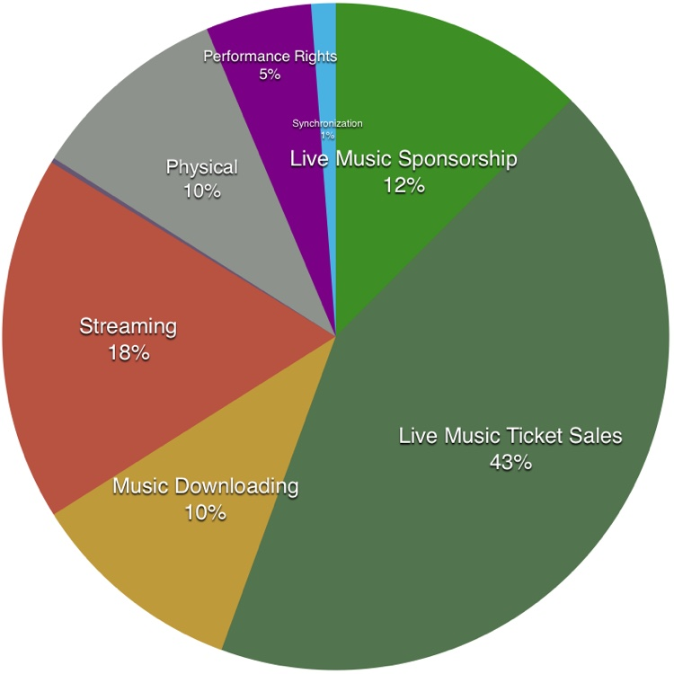
What are you trying to do?
Project Title: Music Industry Visualization & Tour Analytics
Background Information:
The global music industry is expected to reach a value of $31 billion by the year 2022.¹
Ticket sales comprise >40% of music industry revenue.²
Lack dashboards to visualize trends within the music industry
Primary Research Questions:
How to visualize the music industry?
How to predict the success of a music tour?
Breakdown of revenue generating activity in the music industry.²

Slide 3
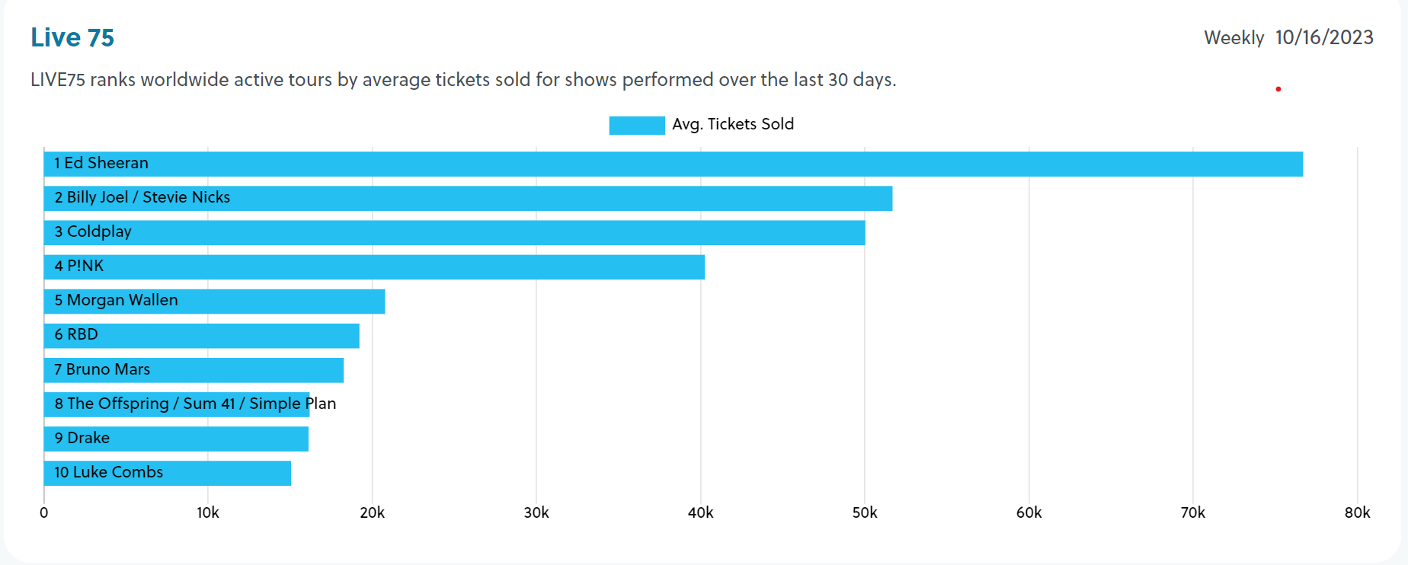
How is it done today?; What are the limits of current practice?
Music Trend Visualizations
Visualization tools are limited within the Spotify app, but using data from their API people can generate their own visualizations.³
Tour Predictions
Prediction models created from:
Vivid Seats which predicts the top 2024 concerts and tours.⁴
Seat Unique which predicts the artists that are likely to tour the UK in 2022/23.⁵
No published document outlines how vivid seats predict music tour success
From https://www.pollstar.com/charts

Slide 4
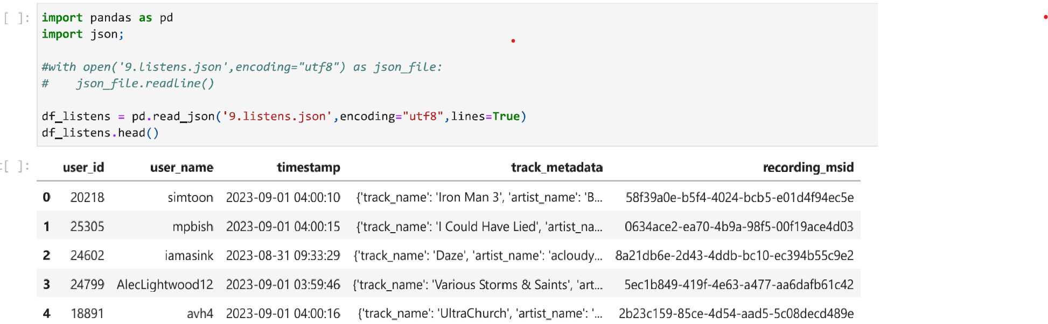
New Approach/Why We Believe in Success (continued)
Music tour success prediction (python) would be novel as the data comes from a variety of platforms:
Musicbrainz
Listenbrainz
Critiquebrianz
Ticket sales
Event venue
Venue weather history
Sample data frame from Listenbrainz.⁷

Slide 5
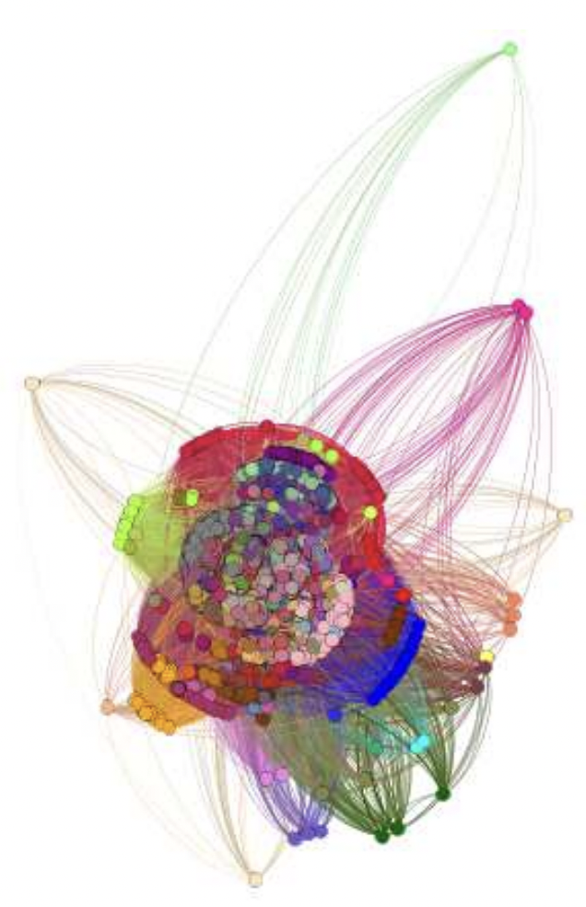
New Approach/Why We Believe in Success
Music dashboards visualizing the below:
Artist Discography
Genre analysis
Top artists by region
Album sales comparison
Collaboration network
Music releases over time
Popular artist by decade
Example of a genre similarity network.⁶

Slide 6

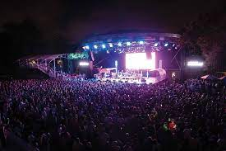
Who Cares?; If you're successful, what difference will it make?
Artists
Entrepreneurs
Financial investors

Slide 7
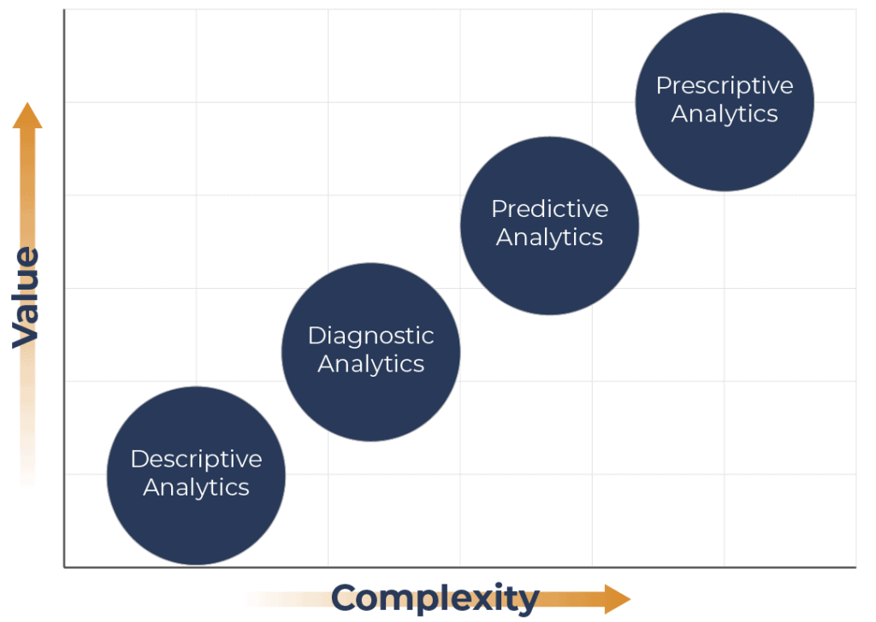
Risks/Payoffs
Risks:
Data Quality and Availability
Complexity of Model
Payoffs:
Industry Insights
Tour Success Prediction
Revenue Generation
Prescriptive analytics show the most complexity to generate.⁸
Notes:
like any model, ours only as good as the data that goes into it. We’re using many sources that are hard to QC , which poses a slight risk. Additionally, predictive and prescriptive models can get pretty complex. We think the payoff of this project is high, though, because people may gain insights that could help plan concerts better. (23s)

Slide 8



How much will it cost?
Pollstar does not provide data free; it's available for $6K per year
Evaluating other sources such as last.fm and songkick.com
How long will it take?
Specific USA region achievable within project timeframe
Full-scale global service requires approximately 2 years with current team
Notes:
If we had more money we would purchase data from Pollstar, but we have no money, so this project will be free and completed within two months. (10s)

Slide 9
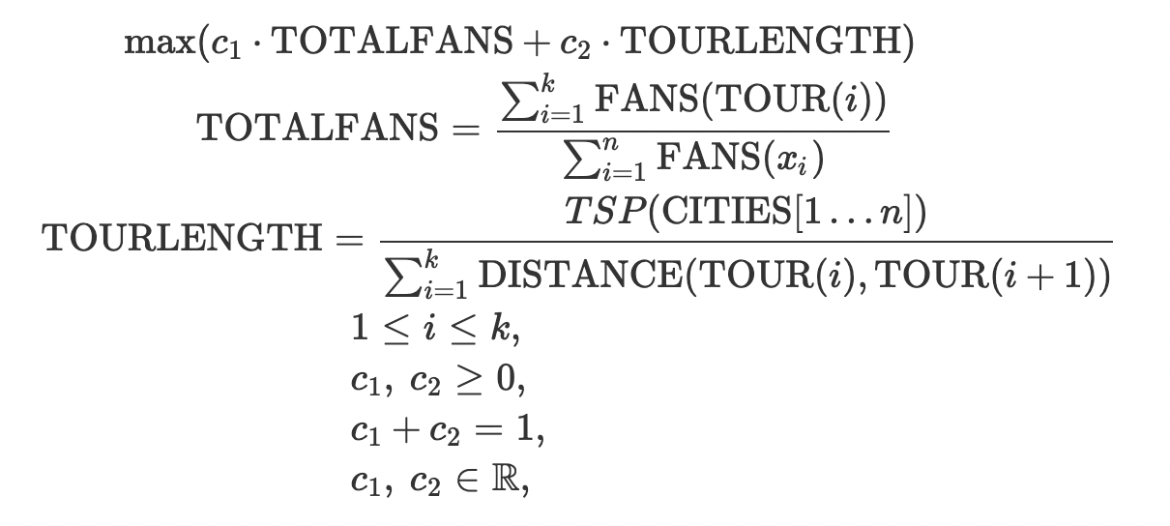
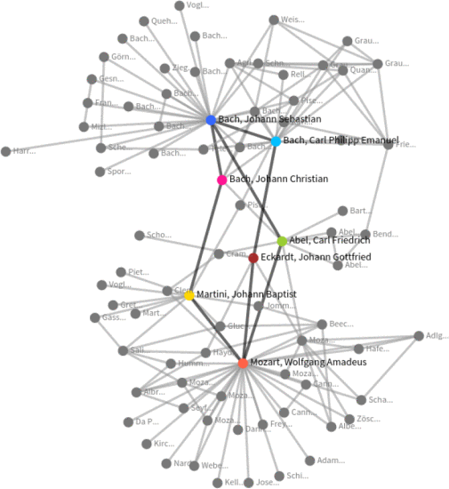
Literature Review (Abridged)
Concert Tour Planning Models
"Optimal City Selection and Concert Tour Planning Based on Heuristic Optimization Methods and the Use of Social Media Analytics"⁹
"Revenue Prediction of Music Concerts Using the Mathematical Model of Hit Phenomena"¹⁰
Music Industry Data Visualization:
"Analyzing and Predicting Success in Music"⁶
"Big Data Visualisation and Visual Analytics for Music Data Mining"¹¹
"Interactive Visual Profiling of Musicians"¹²
Optimization equation for tour planning with the objective of maximizing the number of fans and minimizing travel costs.⁹
Interactive social network of classical musicians.¹²
Notes:
Though our project is novel, there is literature precedent for tour planning using optimization and other math models. We also found in our literature review that the history of music analytics has evolved from exploring complex factors like network structures, genres, and collaboration's impact on success to developing tools for visualizing musical patterns and profiling artists. By using larger, more, and newer datasets we are excited about the potential to build even more meaningful tools for the industry. (30s)

Slide 10
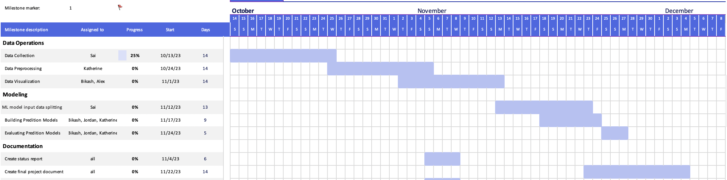
Plan of Activities, Midterm/Final Checks
Midterm checks: A functional interactive tool that shows at least three visualizations of music industry trends.
Final checks: A model that can predict tour revenue. We are aiming for >50% of tour revenue attributable to the model's predictors (R² >0.5).
Notes:
Here you can see our plan of activities from data collection to model evaluation and UI development. Our midterm goal is to have a working interactive tool with at least 3 visualizations. Our final check would be a model that can predict tour revenue with a moderate R-squared. (20s)

Slide 11
References
Sanchez, Daniel. "The Live Music Industry Will Be Worth $31 Billion Worldwide by 2022." Digital Music News, 26 Oct. 2018, www.digitalmusicnews.com/2018/10/26/latest-live-music-revenue-31-billion-2022/.
Resnikoff, P. "Live Concerts + Streaming = 73% of the US Music Industry." Digital Music News, 2017, www.digitalmusicnews.com/2017/06/07/music-industry-concerts-streaming/.
Pan, Y. "Step by Step to Visualize Music Genres with Spotify API." Medium, 7 Dec. 2021. Retrieved from https://towardsdatascience.com.
Marx, Madison. "2024 Concert Tours: Predicting the Top 2024 Concerts and Tours." Vivid Seats, 3 Mar. 2023, www.vividseats.com/blog/2024-concert-tour-predictions.
Parkes, Gemma. "Top Music Tour & Concert Predictions for 2022/23." Seat Unique - Blog, 9 Nov. 2022, www.seatunique.com/blog/concert-tour-predictions.
Kang, I., Manduluk, M., & Szymański, B. K. "Analyzing and Predicting Success in Music." Research Square, 2022. https://doi.org/10.21203/rs.3.rs-1772541/v1.
MusicBrainz - The Open Music Encyclopedia. (n.d.-b). Retrieved from https://musicbrainz.org/.
Kalsbeek, R. "Understanding the Different Types of Analytics: Descriptive, Diagnostic, Predictive, and Prescriptive." Iteration Insights, 2023. Retrieved from https://iterationinsights.com/article/understanding-the-different-types-of-analytics/.
S. Delalić, M. Chahin and A. Alihodžić. "Optimal City Selection and Concert Tour Planning Based on Heuristic Optimization Methods and the Use of Social Media Analytics." 2019 XXVII International Conference on Information, Communication and Automation Technologies (ICAT), Sarajevo, Bosnia and Herzegovina, 2019, pp. 1-6. doi: 10.1109/ICAT47117.2019.8939040.
Y. Kawahata, E. Genda and A. Ishii. "Revenue Prediction of Music Concerts Using the Mathematical Model of Hit Phenomena." 2013 International Conference on Biometrics and Kansei Engineering, Tokyo, Japan, 2013, pp. 208-213. doi: 10.1109/ICBAKE.2013.41.
K. E. Barkwell et al. "Big Data Visualization and Visual Analytics for Music Data Mining." 2018 22nd International Conference Information Visualization (IV), Fisciano, Italy, 2018, pp. 235-240. doi: 10.1109/iV.2018.00048.
S. Jänicke, J. Focht and G. Scheuermann. "Interactive Visual Profiling of Musicians." IEEE Transactions on Visualization and Computer Graphics, vol. 22, no. 1, 31 Jan. 2016, pp. 200-209. doi: 10.1109/TVCG.2015.2467620.

